Slide 1
Bristol Temple Meads
Aspect – GWR’s LGBT+ Network

Slide 3
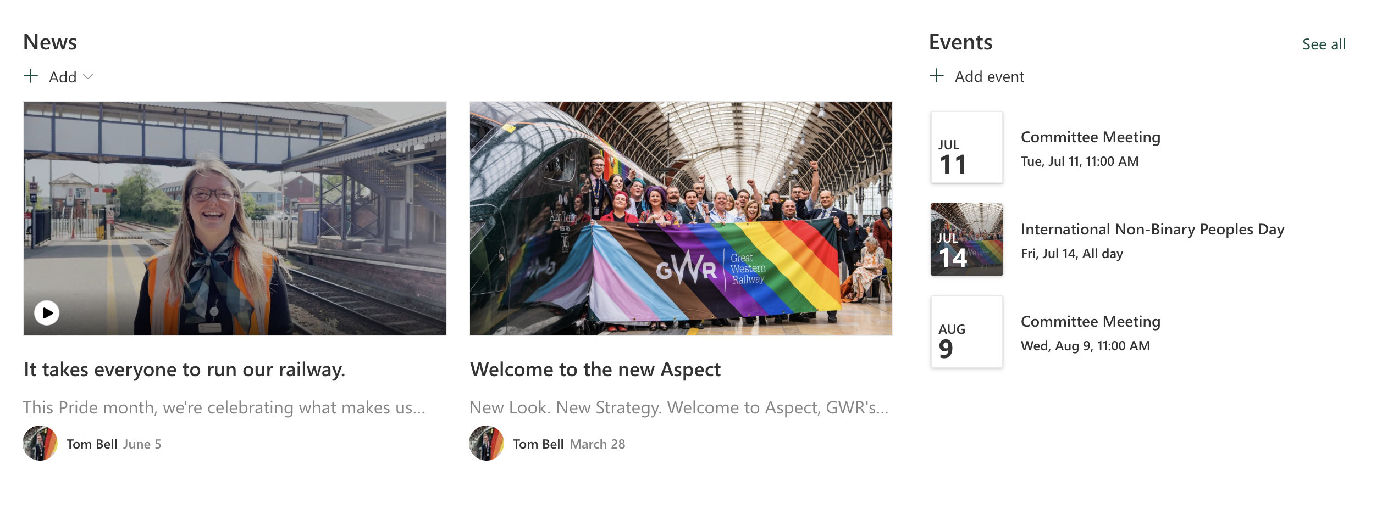
Aspect portal
gwr.to/aspect
Aspect is proud to introduce a new online portal dedicated to its LGBT+ network. This platform provides GWR colleagues with the opportunity to sign up and become part of aspect, to create a supportive and inclusive community. Through the online portal, network members can stay informed about the latest news, access meeting minutes, and actively participate in discussions and initiatives.
The platform serves as a central hub for LGBT+ employees to connect, find resources, and seek support.

Slide 4
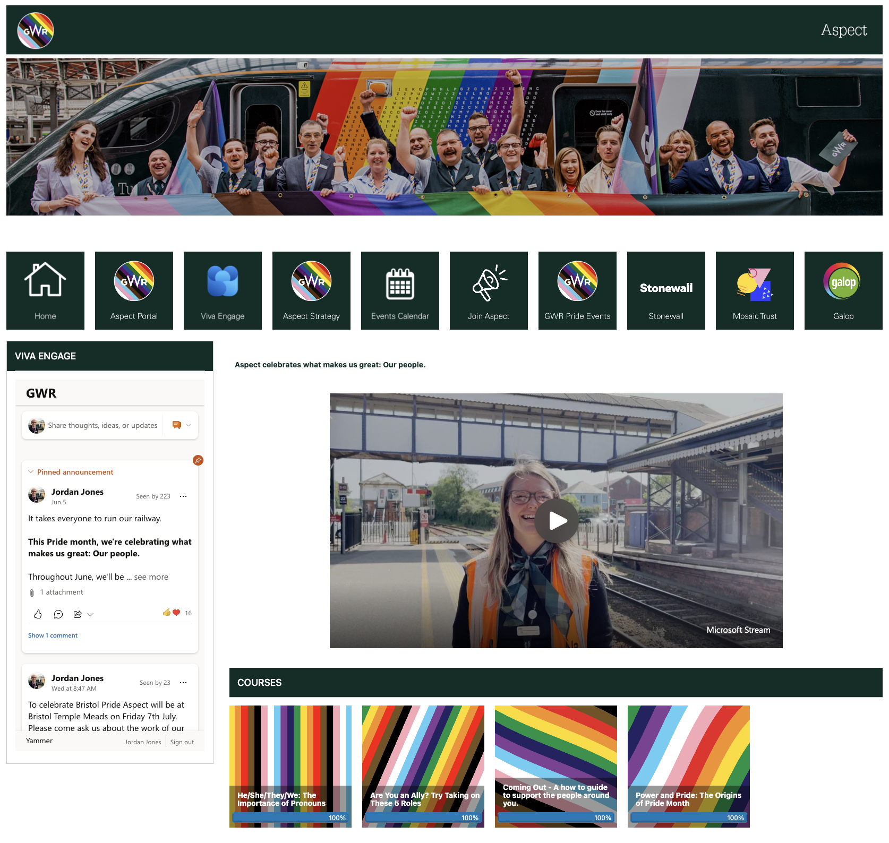
Education resources
gwr.to/aspectlearning
Aspect is committed to providing a range of diverse and inclusive learning packages, and as part of that commitment, we offer a range of LGBT+ inclusive education resources on assessbook. These resources aim to promote understanding, acceptance, and equality for the LGBT+ community.
Assessbook's LGBT+ inclusive education resources cover a wide range of topics, including history, social issues, identity, and diversity. They are designed to facilitate open and respectful discussions, challenge biases and stereotypes, and foster a safe and inclusive learning environment for all

Slide 5
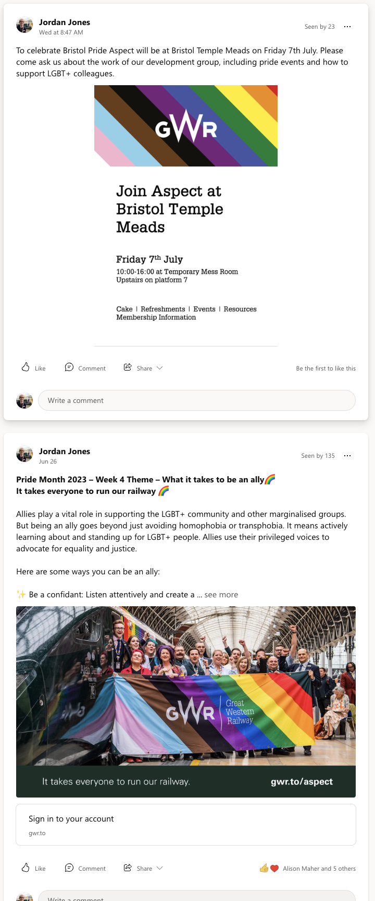
Viva Engage (Yammer)
Join the discussion
Join Aspect on Viva engage, our internal social media platform dedicated to promoting LGBT+ inclusion within GWR. By following Aspect on Viva engage, you will have access to the latest updates, news, and resources related to LGBT+ inclusion in the workplace.
It's an opportunity to stay informed about upcoming events, initiatives, and important discussions happening GWR. You'll be able to join conversations, share your insights, and connect with colleagues who are passionate about creating an inclusive and supportive environment for everyone.
Aspect on Viva engage is a space where your voice matters, and we encourage you to actively participate, contribute, and help shape our LGBT+ inclusion efforts. Together, we can foster a workplace where everyone feels respected, valued, and celebrated for who they are. Join us on Viva engage and let's make a positive difference in our organization and beyond.

Slide 6
Aspect
gwr.to/aspect

Slide 7
Coming out
It takes everyone to run our railway
Coming out is an incredibly brave and empowering act 🏳️‍🌈 It takes a great deal of courage for a person to embrace their true self and share their authentic identity with the world. 💙💜💖
To all the incredible individuals who have come out, congratulations! 🎉🌈 Your strength, vulnerability and self-acceptance inspire us all. You are a shining example of living your truth, and we are here to support you every step of the way. 🤗💪
If you're still in the process of coming out, know that you are not alone. Reach out to trusted friends, family or supportive communities who will embrace you with open arms. We're here to listen, to understand, and to love you for who you are, exactly as you are. ❤️🧡💛💚💙💜
It is important that we understand coming out is an ongoing process and each person's journey is unique. It's crucial that we create safe and inclusive spaces where everyone feels loved, accepted and respected. 🤝🌍

Slide 8
He/She/They/We – The importance of pronouns
It takes everyone to run our railway
🌈 Language is a powerful tool that reflects our values and beliefs. As a non-binary person, the correct use of pronouns holds deep significance in my life. Learning why accurate and respectful pronoun usage is vital, not just for me, but for the LGBT+ community as a whole. Understanding and respecting pronouns is an essential step towards an inclusive and affirming society. 🏳️‍⚧️
Pronouns may seem small, but their impact goes beyond literal meaning. Using the correct pronouns validates a person’s identity, reminding them that who they are is deserving of acknowledgment. It creates safety and acceptance, allowing them to express themselves authentically. It is important to recognise that pronouns are more than grammar; they are about personal dignity. 🙌
Misusing pronouns, intentional or not, can deeply affect someone's wellbeing. It causes a sense of not being seen or understood. I've experienced the pain of being misgendered, and it takes an emotional toll. When we take the time to learn and use correct pronouns, we demonstrate allyship and respect. It creates an inclusive environment where everyone can be their authentic selves. 🤝
Remember, pronouns matter for everyone, not just the LGBT+ community. Respecting and using pronouns acknowledges the diverse identities within our society. By normalising the practice of asking for and using preferred pronouns, we dismantle assumptions and foster acceptance for all genders. Let's create an atmosphere where everyone can be seen and valued.

Slide 9
What pride means to me
It takes everyone to run our railway
As Pride month rolls around every June, some may ask, "Why do we need pride month?" And it's a valid question. LGBT+ rights have undeniably made significant progress, but there's still a long road ahead. In our current climate, where national entities try to silence and misrepresent LGBTQ+ individuals, Pride remains as crucial as ever.
Pride is more than just a colourful party. It traces back to June 28, 1969, in New York City. In the early hours of the morning, police raided the Stonewall Inn, a beloved Greenwich Village bar for LGBTQ+ patrons. After enduring escalating harassment from authorities, the officers expected a quiet dispersal. But tensions reached a breaking point. Protesters fought back, hurling bricks, bottles, rocks, and Molotov cocktails at the police, who barricaded themselves inside the bar. This riot persisted until after 4 a.m., astonishingly without any casualties.
Today, when we celebrate Pride, we fight against the systems that hinder progress. By being visible and standing together, we remind the world that we are a community unwilling to be silenced. We refuse to be ignored; our voices and struggles demand recognition.

Slide 10
🌈 "It means getting to celebrate being my most authentic self and rejoicing in the identities of those around me." – Lexi
🌈 "Pride to me serves as a reminder of the battles we've fought and continue to face. Those before me marched and fought for our rights and lives. Today, I carry on that fight and stand in solidarity with those affected by a history of systemic homophobia and transphobia." – Katja
🌈 "To me, it means being able to be completely and unapologetically myself, free from judgment. It signifies that while we have come a long way, there's still progress to be made. We are here and we are here to stay." - Frank

Slide 11
What it takes to be an Ally
It takes everyone to run our railway
Allies play a vital role in supporting the LGBT+ community and other marginalised groups. But being an ally goes beyond just avoiding homophobia or transphobia. It means actively learning about and standing up for LGBT+ people. Allies use their privileged voices to advocate for equality and justice.
Here are some ways you can be an ally:
✨ Be a confidant: Listen attentively and create a safe space for underrepresented individuals to share their stories and experiences.
✊ Be a champion: Speak out boldly against injustice and support marginalised individuals in public spaces, making sure their voices are heard.
📢 Be an amplifier: Help raise the voices of marginalised individuals, ensuring that everyone gets the opportunity to be heard and their perspectives are respected.
🤝 Be a sponsor: Advocate for the career advancement of others, particularly those who are overshadowed or overlooked in the workplace.
⚔️ Be an upstander: Stand up against offensive behaviour and push back, even when marginalised individuals are not present. Challenge prejudice and discrimination wherever you encounter it.

Slide 13
Bristol Pride 2023

Slide 14
Section title
Presenter name
Job title

Slide 15
Section title
Presenter name
Job title

Slide 16
Section title
Presenter name
Job title

Slide 17
Section title
Presenter name
Job title

Slide 18
Section title
Presenter name
Job title

Slide 19
Section title
Presenter name
Job title

Slide 20
Section title
Presenter name
Job title

Slide 21
Section title
Presenter name
Job title

Slide 22
Section title
Presenter name
Job title

Slide 23
Section title
Presenter name
Job title

Slide 24
Section title
Presenter name
Job title

Slide 25
Section title
Presenter name
Job title

Slide 26
Section title
Presenter name
Job title

Slide 27
Section title
Presenter name
Job title

Slide 28
Section title
Presenter name
Job title

Slide 29
Section title
Presenter name
Job title

Slide 30
Section title
Presenter name
Job title

Slide 31
Section title
Presenter name
Job title

